Slide 1
What is data science?
Programming
data
statistics
Data Science

Slide 2
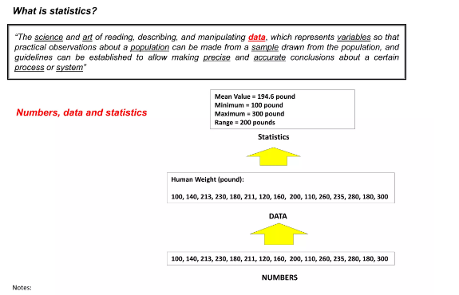

Slide 3
Statistics/Data/information
Numbers are called data when they reflect
information .
Data on the other hand are called statistics
when they reflect descriptive measures of
the phenomenon of the event under study.

Slide 4
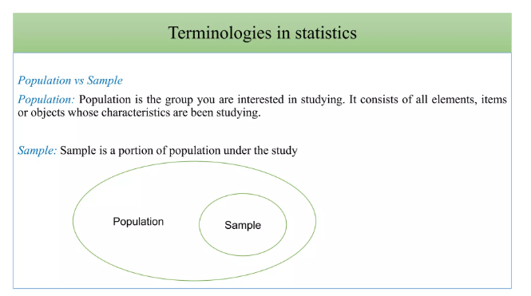

Slide 5
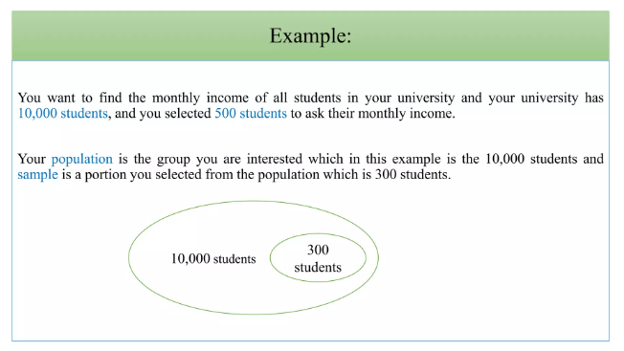

Slide 6
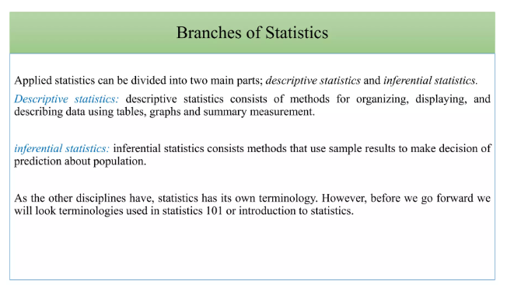

Slide 7
Kind Of Statistics
Descriptive Statistics – Used to describe the basic feature of data in a study.
Measure of Central Tendency
Measure of Dispersion

Slide 8
Inferential Statistics- Used to make judgement ,Observe difference between groups ,draw inferences, reach conclusion beyond the immediate data.
Hypothesis testing
Corelation Testing

Slide 9
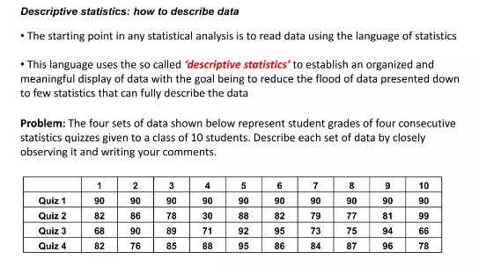
Descriptive statistics

Slide 10
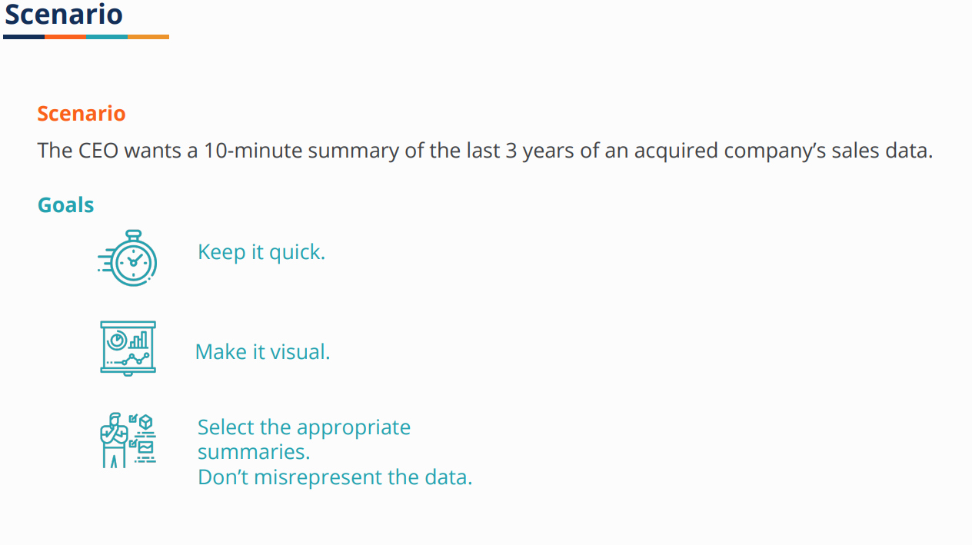

Slide 11
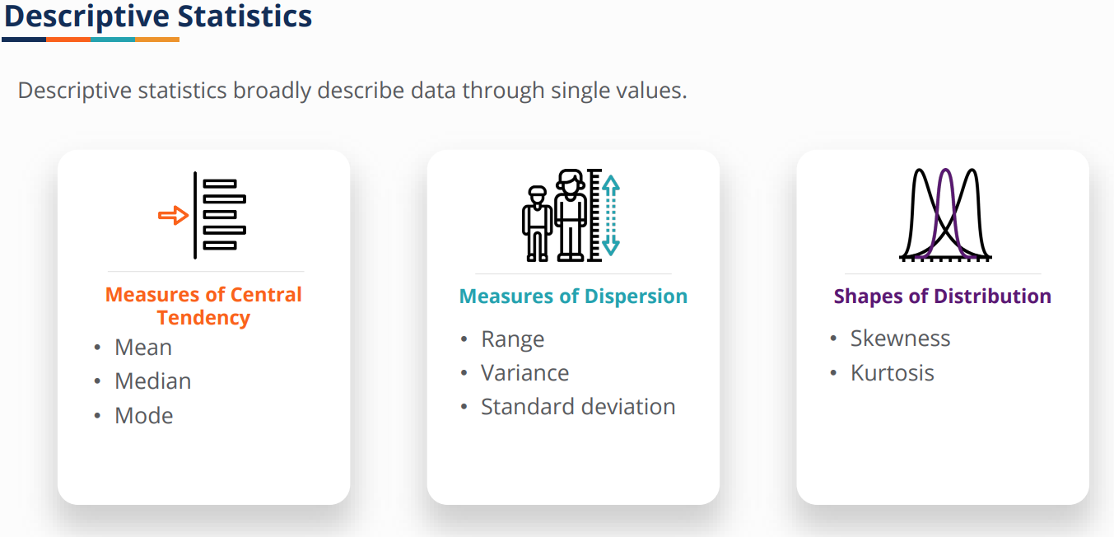

Slide 12
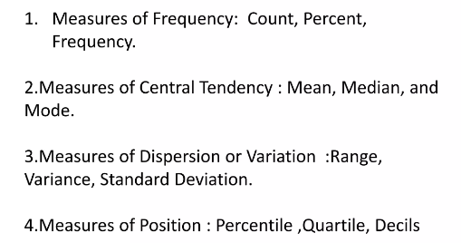
Descriptive statistics

Slide 13
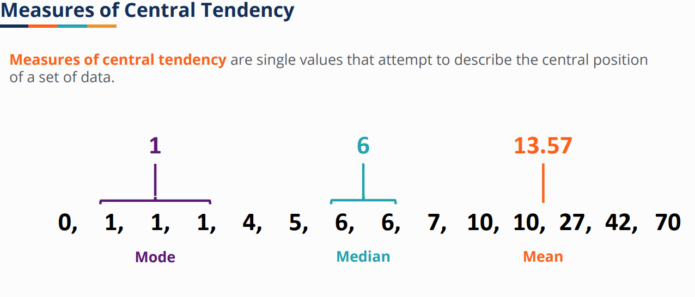
Descriptive Statistics

Slide 14
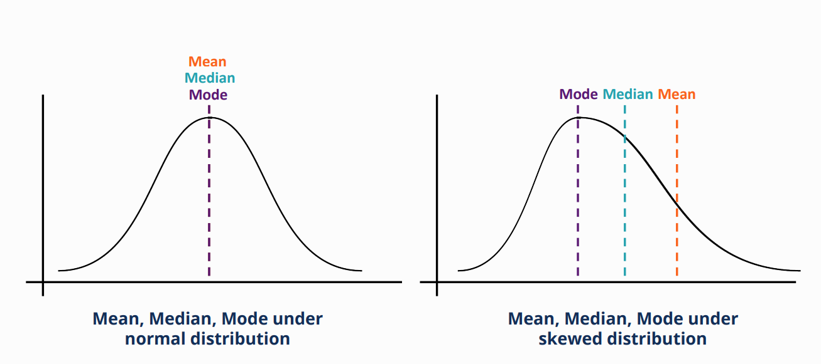
Normal DISTRIBUTION

Slide 15
MEAN MEDIAN MODE
When not to use the mean
The mean has one main disadvantage: it is particularly susceptible to the influence of outliers. These are values that are unusual compared to the rest of the data set by being especially small or large in numerical value. For example, consider the wages of staff at a factory below:
Staff | 1 | 2 | 3 | 4 | 5 | 6 | 7 | 8 | 9 | 10
Salary | 15k | 18k | 16k | 14k | 15k | 15k | 12k | 17k | 90k | 95k

Slide 16
MEDIAN(Less affected by outliers)
The median is the middle score for a set of data that has been arranged in order of magnitude. The median is less affected by outliers and skewed data. In order to calculate the median, suppose we have the data below:
65 | 55 | 89 | 56 | 35 | 14 | 56 | 55 | 87 | 45 | 92
We first need to rearrange that data into order of magnitude (smallest first):
14 | 35 | 45 | 55 | 55 | 56 | 56 | 65 | 87 | 89 | 92

Slide 17
Consider Again?
WHAT is better MEAN or MEDIAN?
Staff | 1 | 2 | 3 | 4 | 5 | 6 | 7 | 8 | 9 | 10
Salary | 15k | 18k | 16k | 14k | 15k | 15k | 12k | 17k | 90k | 95k

Slide 18
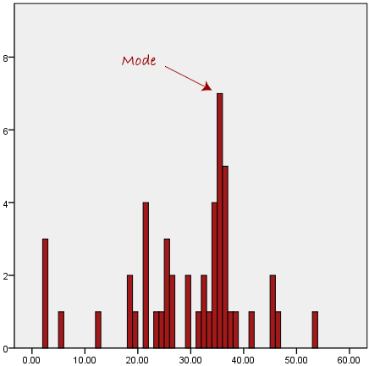
MODE
The mode is the most frequent score in our data set. On a histogram it represents the highest bar in a bar chart or histogram. You can, therefore, sometimes consider the mode as being the most popular option. An example of a mode is presented below:

Slide 19
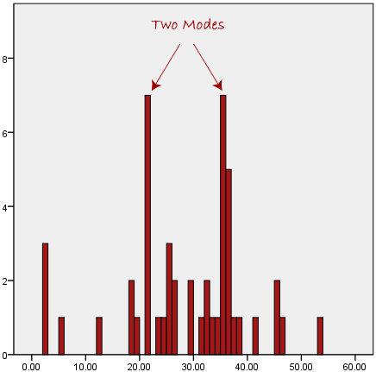
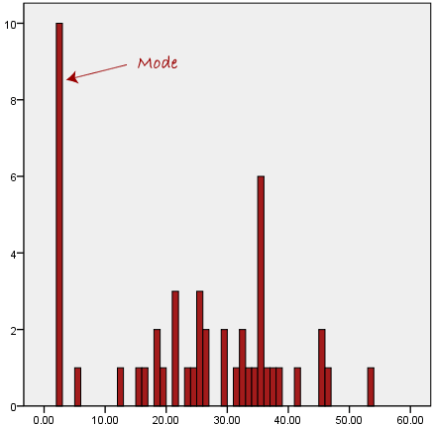
Problem with mode

Slide 20
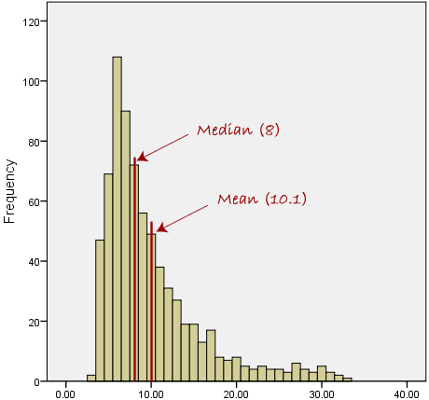
What happens when the data is skewed?

Slide 21

When to use what?

Slide 22

Consider the type of variables
variable
categorical
Nominal(same value categories)
Ordinal(values are ordered)
continuous
Ratio(0 is unacceptable value)
Interval(some numerical values)

Slide 23
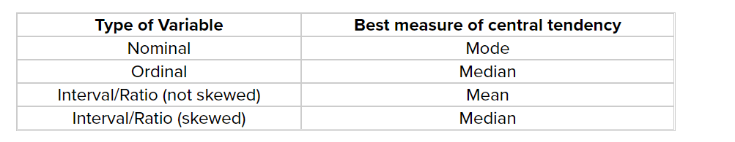
Remember this....

Slide 24
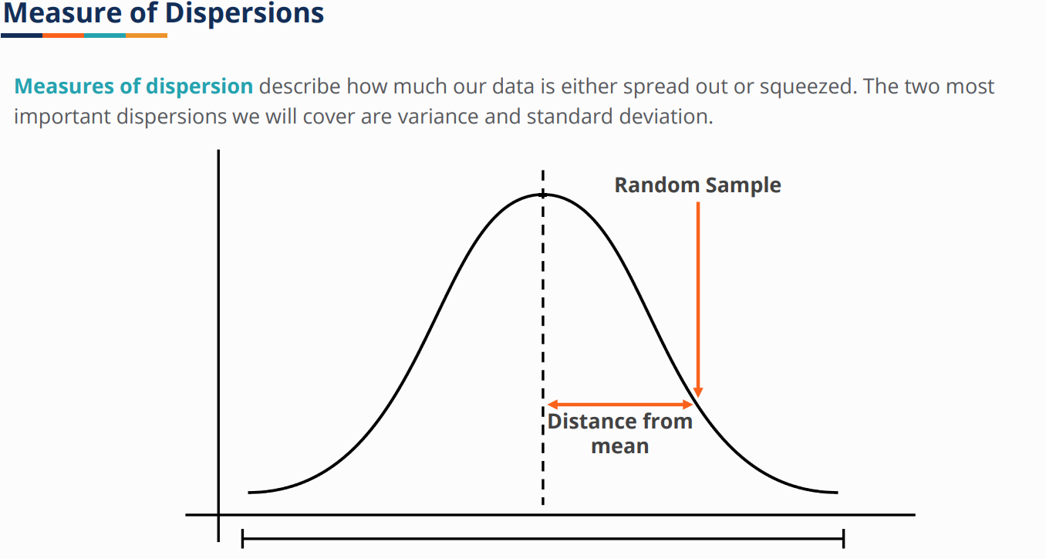

Slide 25
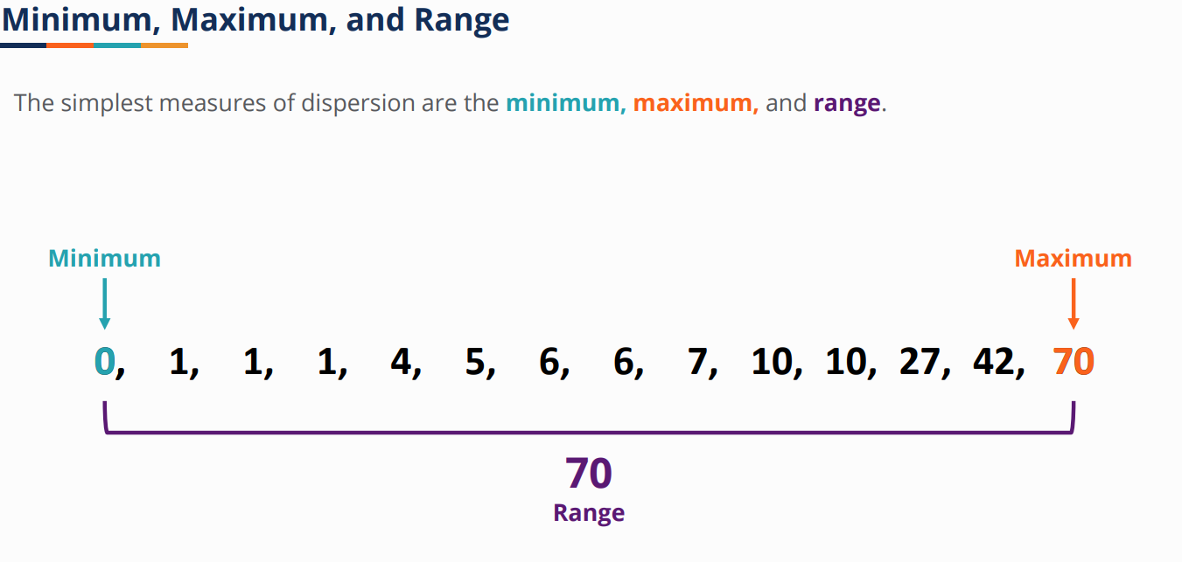

Slide 26
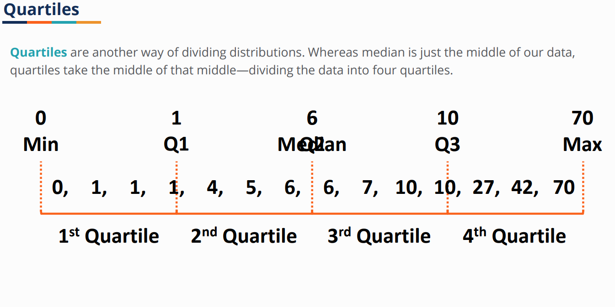

Slide 27
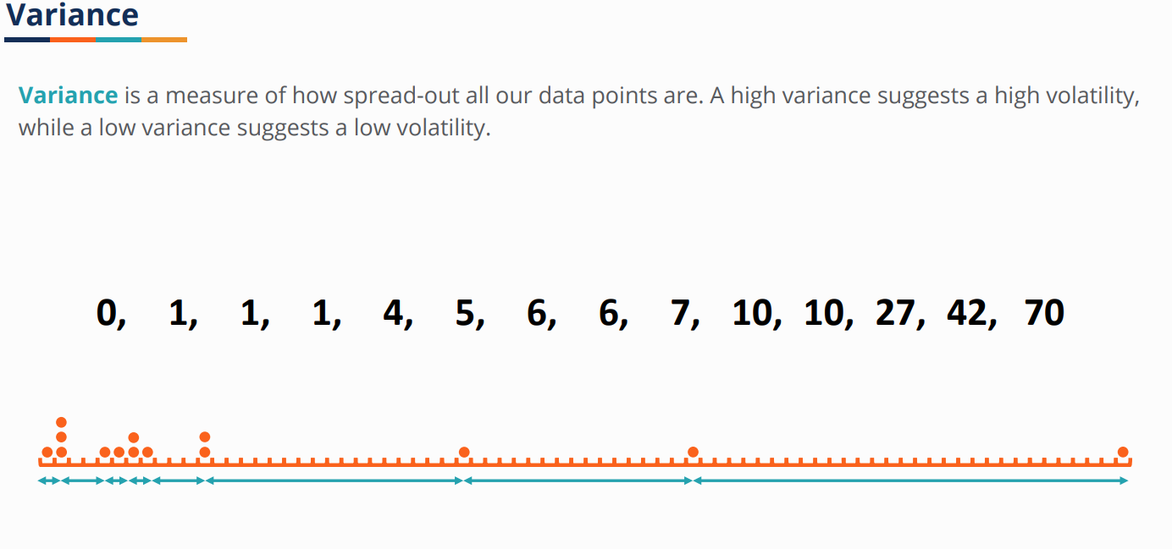

Slide 28
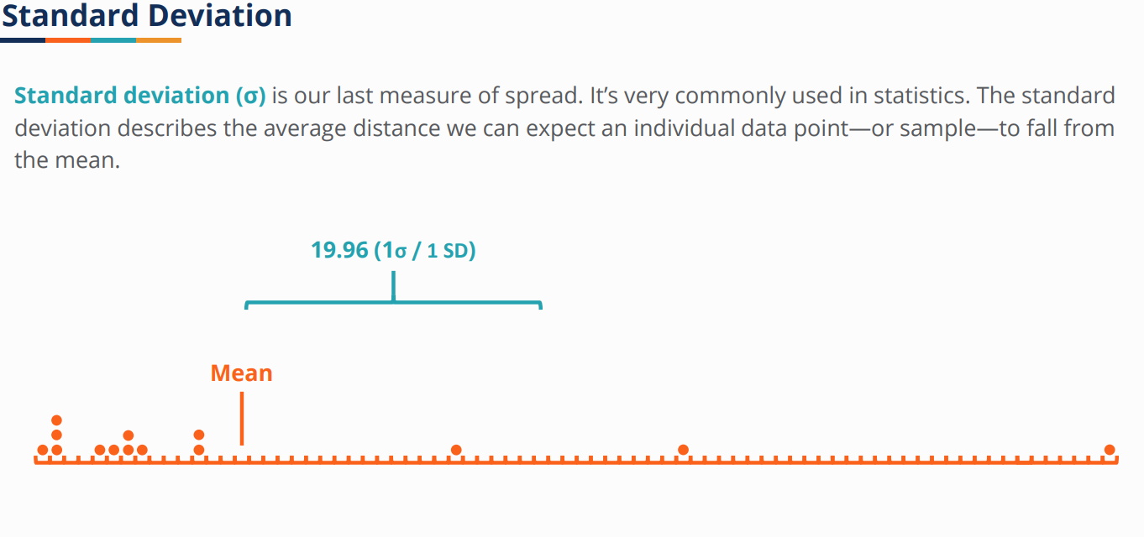

Slide 29
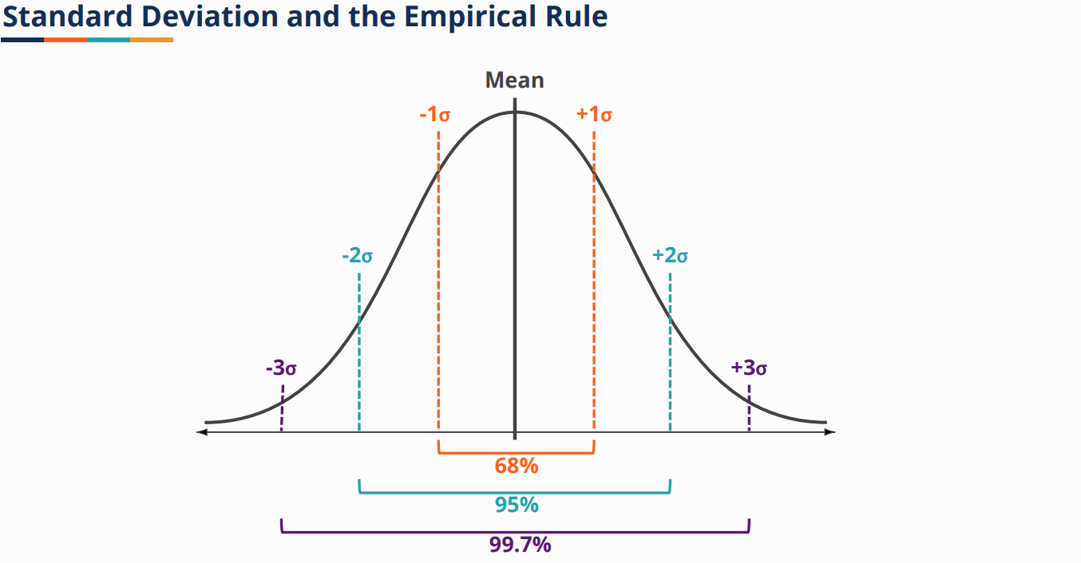

Slide 30
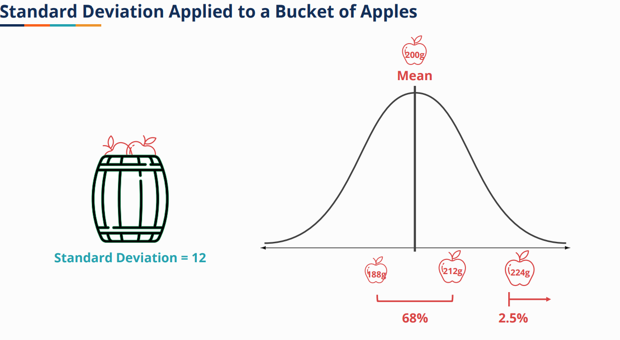

Slide 31
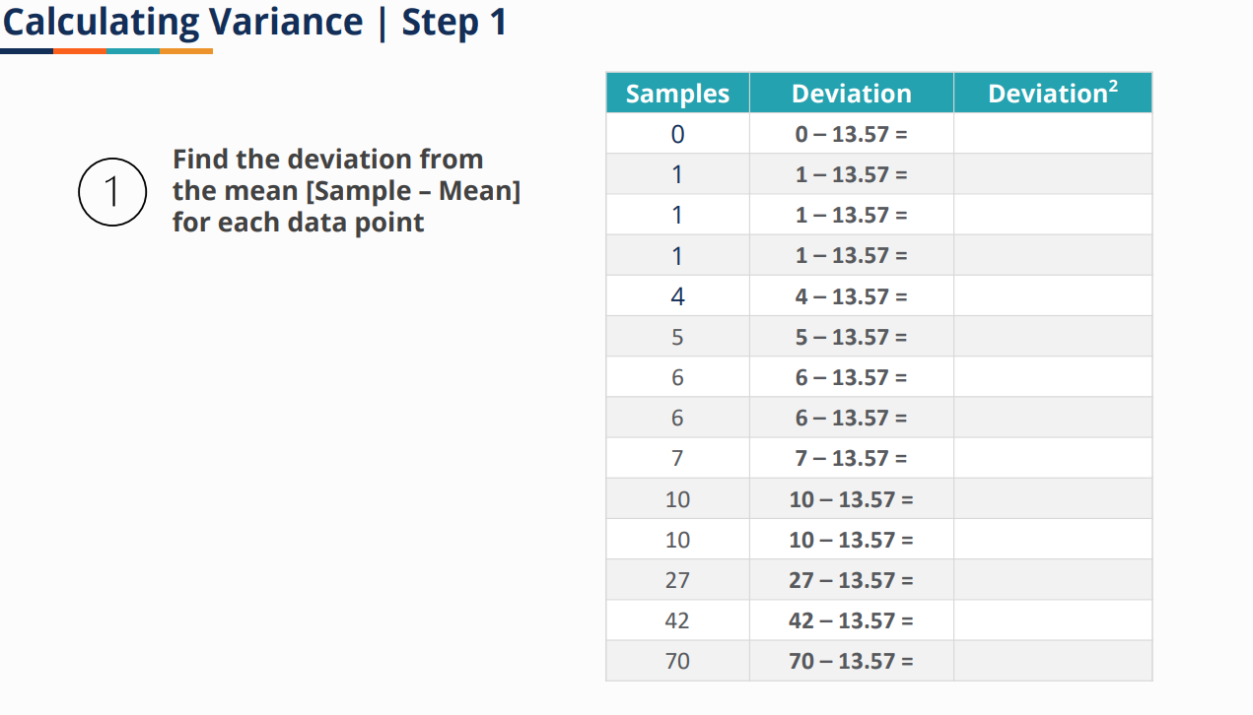
Calculating Variance and standard deviation

Slide 32
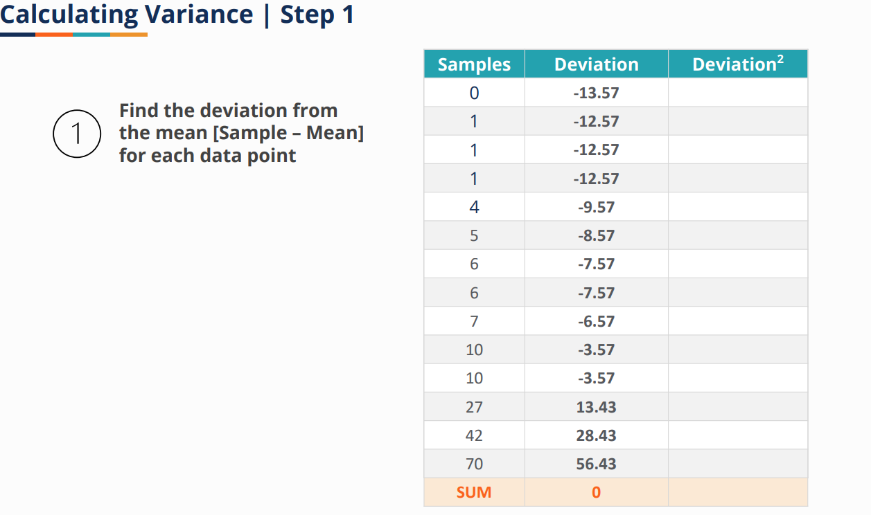

Slide 33
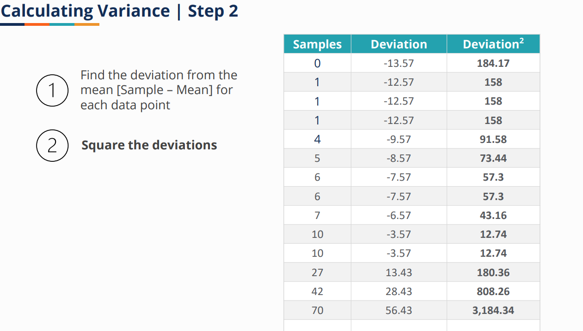

Slide 34
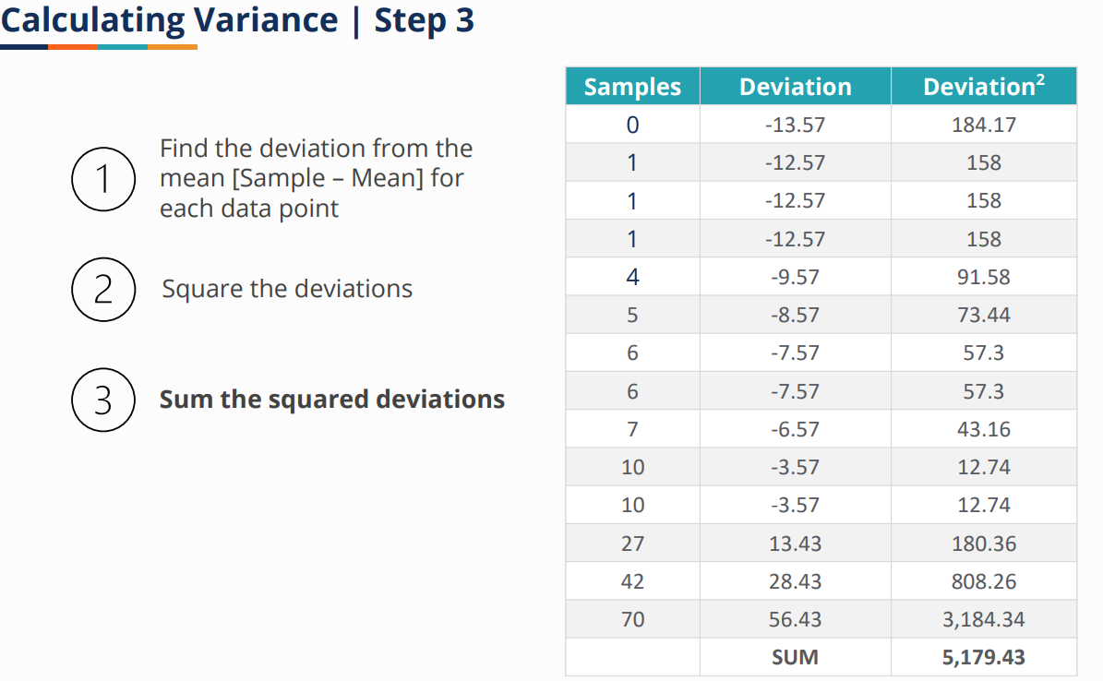

Slide 35
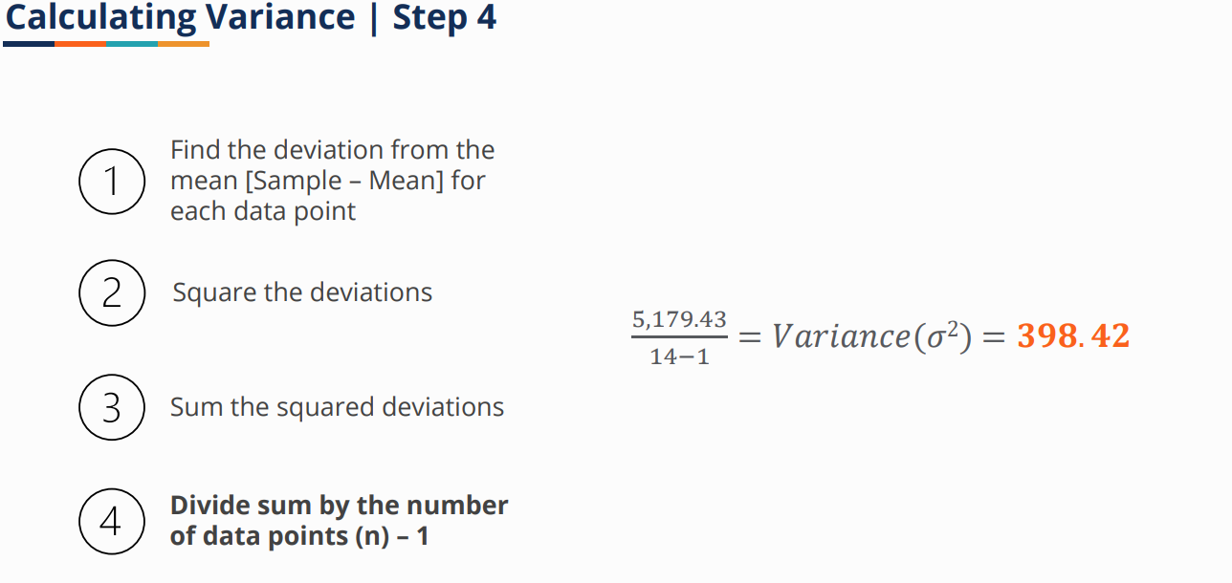

Slide 36
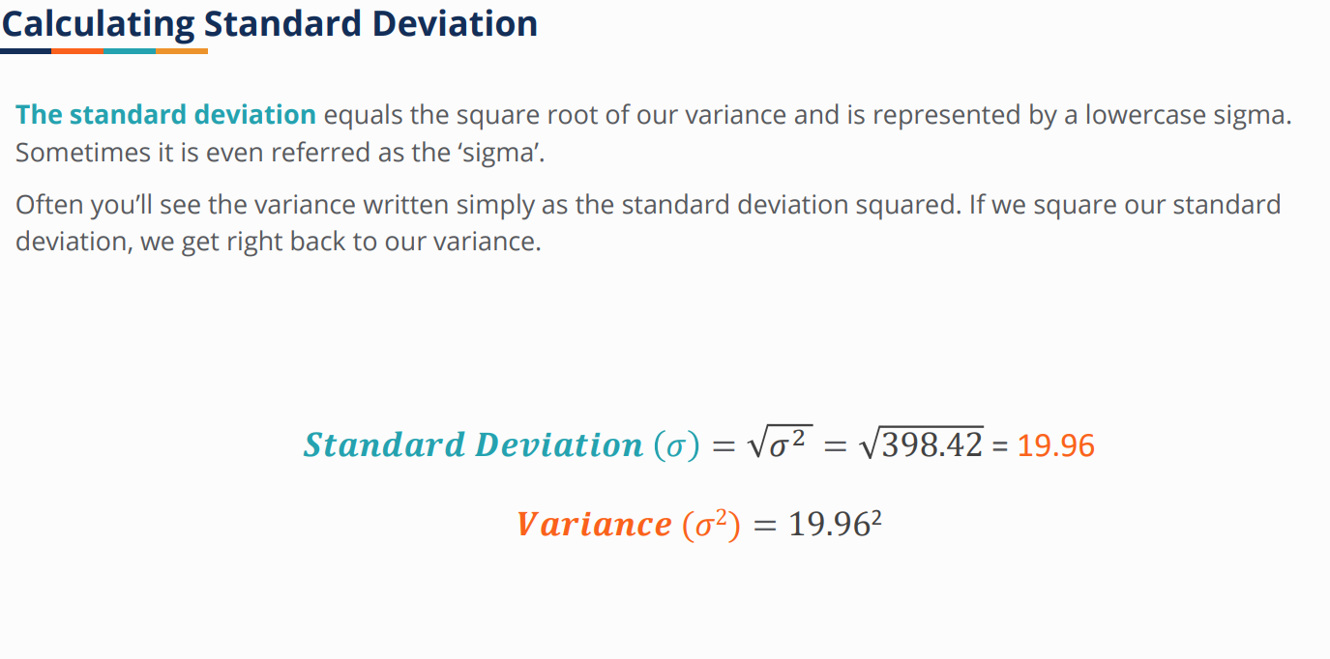

Slide 37
Eye openers
Standard deviation is a measure of heterogeneity in a given set of data.
1.Suppose two batsmen A and B have the same mean score in the earlier matches they played. If we need to select only one of them in the team, then who should be selected?
Obviously the one with less standard deviation as he is more consistent or reliable than the other.
2. If I wish to invest money in either shares of company A or company B, which company should I invest in?
If I am a short term trader, I should invest in company whose daily price has a larger standard deviation so as to take advantage of short term fluctuations in price. If standard deviation of price is low, the price is likely to be relatively the same, not giving much scope for short term gains.
3. Suppose there are two brands of say Tyres with the same mean and price. Which brand should you buy?
Obviously the one with less standard deviation.
4. Any product of a company is deemed good if it's measure of quality has a predefined mean and low standard deviation.

Slide 38
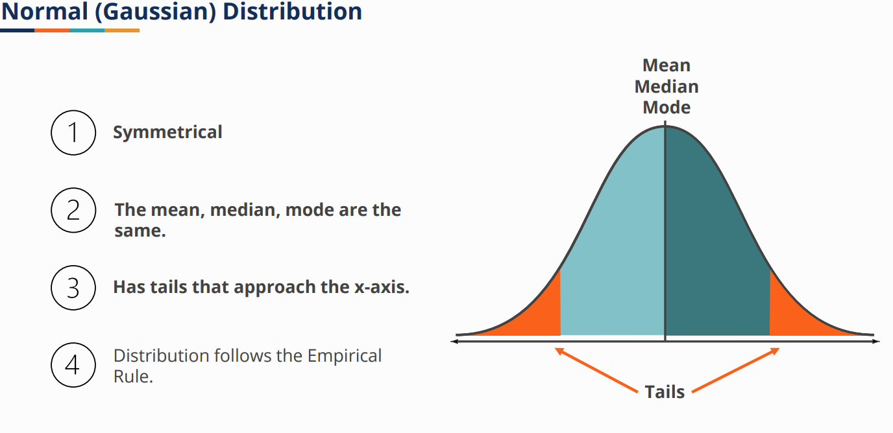
Common distribution

Slide 39
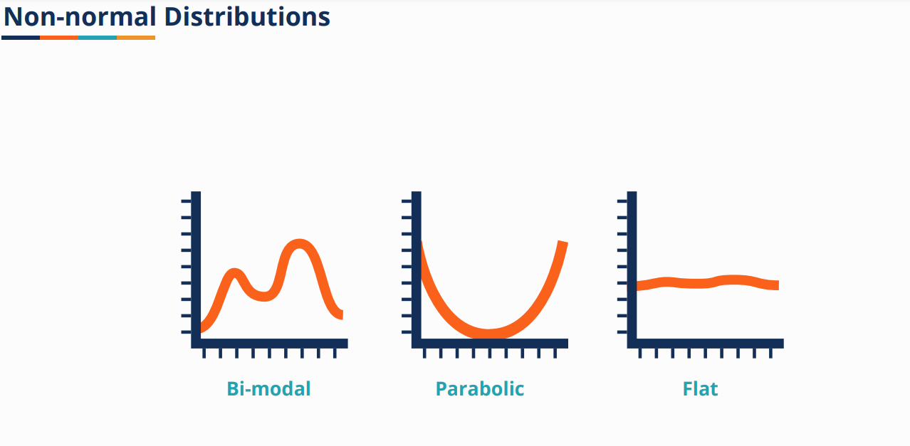

Slide 40
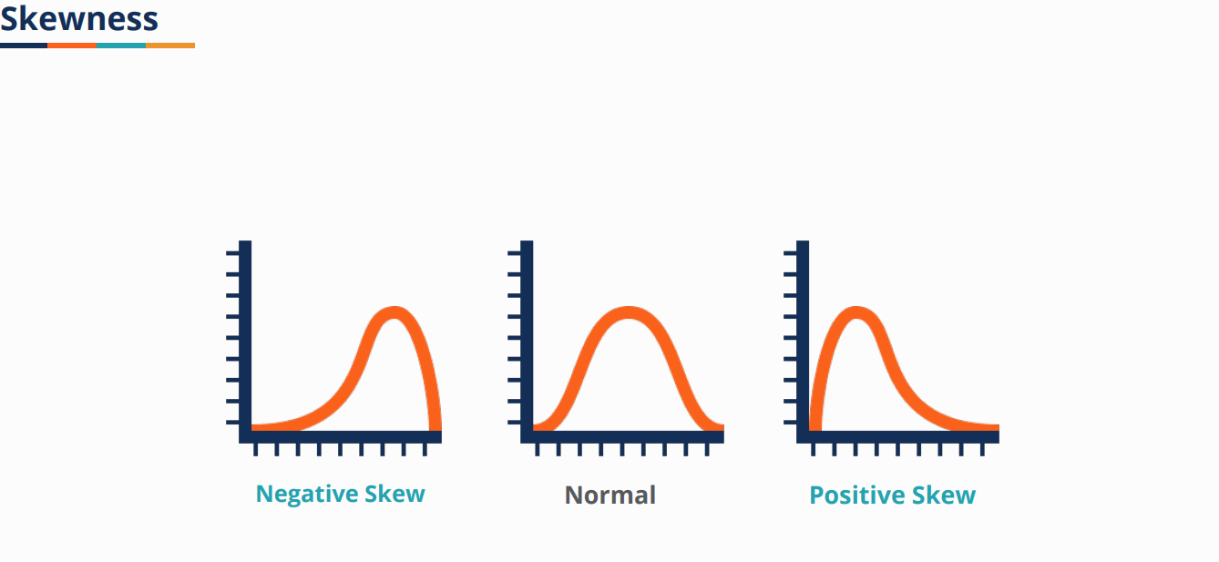
Skewness is usually described as a measure of a dataset’s symmetry – or lack of symmetry. A perfectly symmetrical data set will have a skewness of 0. The normal distribution has a skewness of 0. A positive skewness indicates that the size of the right-handed tail is larger than the left-handed tail and vise versa.

Slide 41
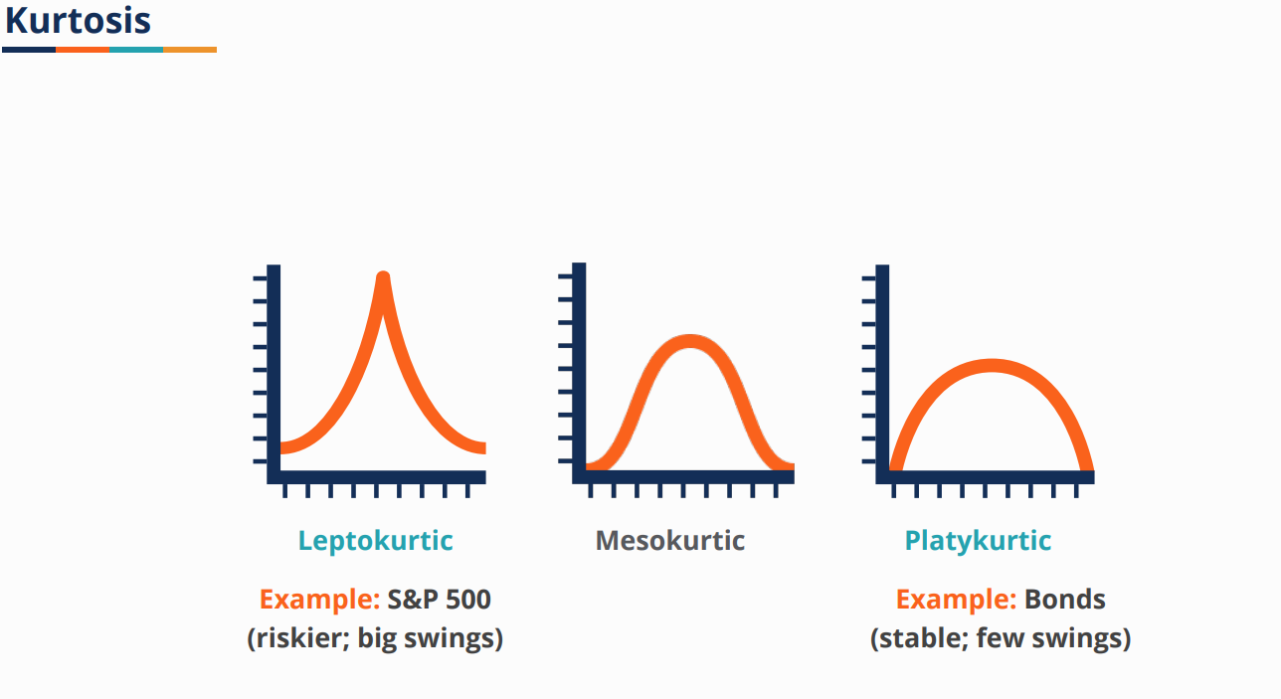
Kurtosis is a measure of the combined sizes of the two tails. It measures the amount of probability in the tails. The value is often compared to the kurtosis of the normal distribution, which is equal to 3. If the kurtosis is greater than 3, then the dataset has heavier tails than a normal distribution (more in the tails). If the kurtosis is less than 3, then the dataset has lighter tails than a normal distribution (less in the tails)

Slide 42
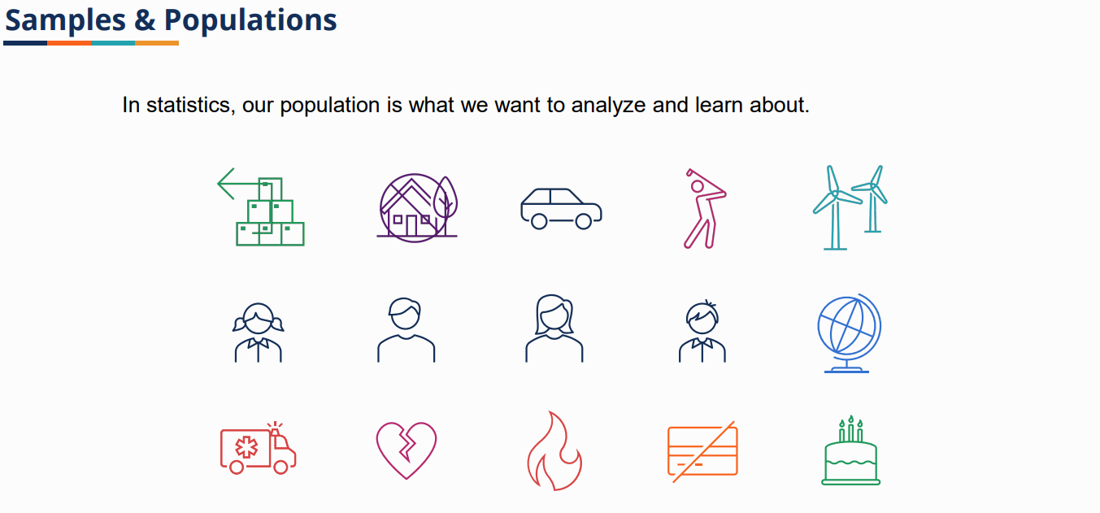

Slide 43
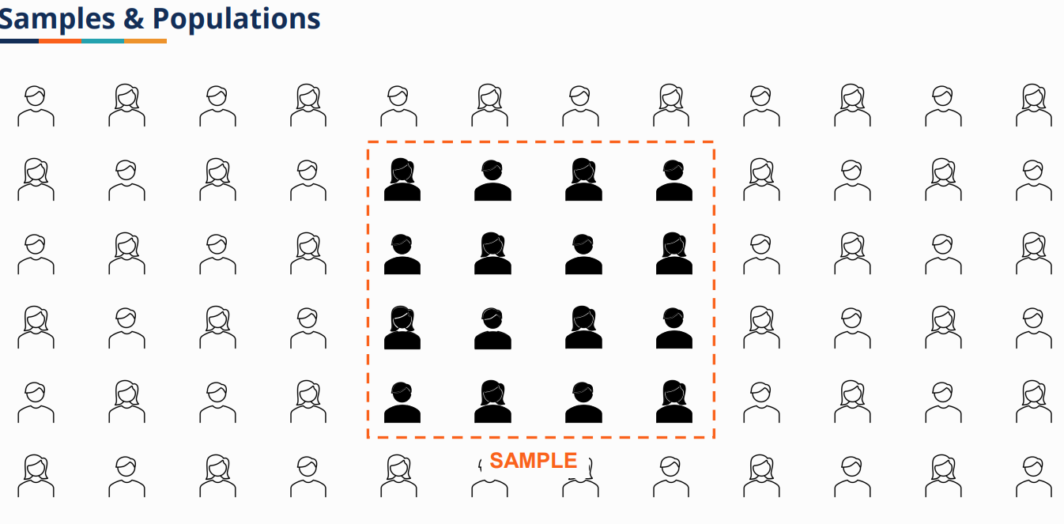

Slide 44
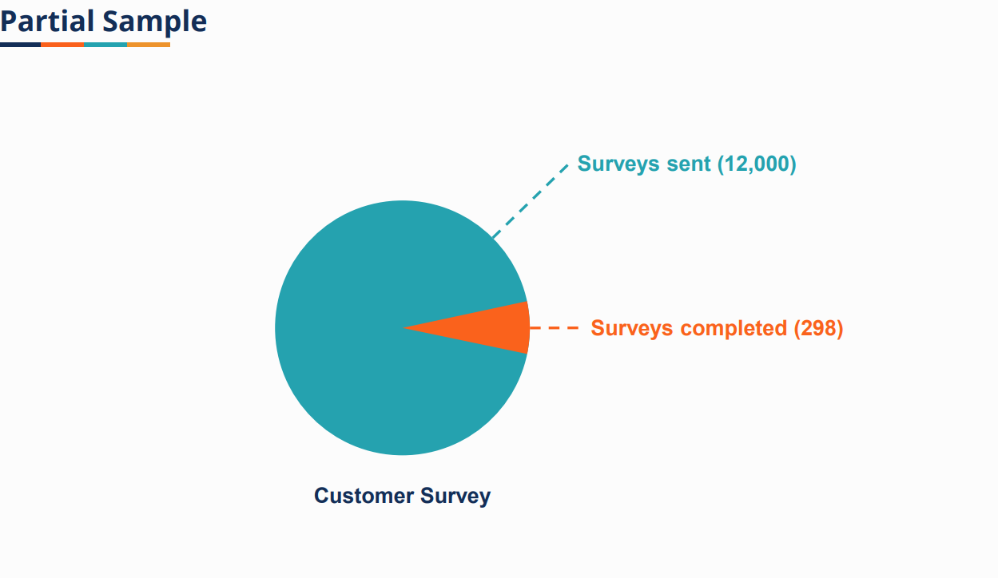

Slide 45
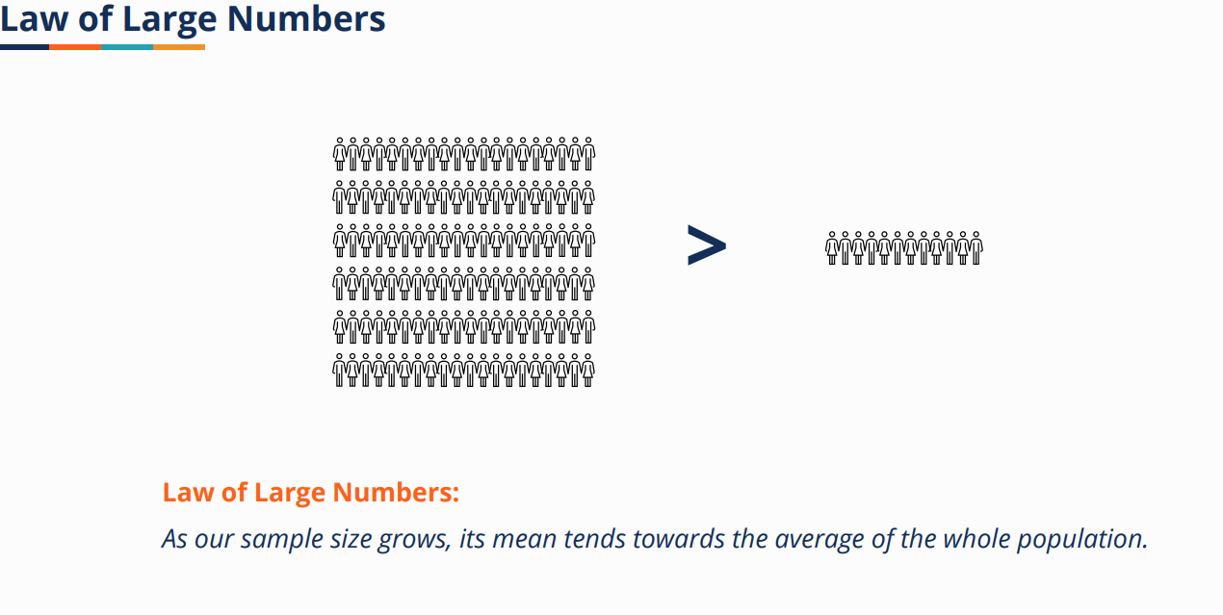

Slide 46
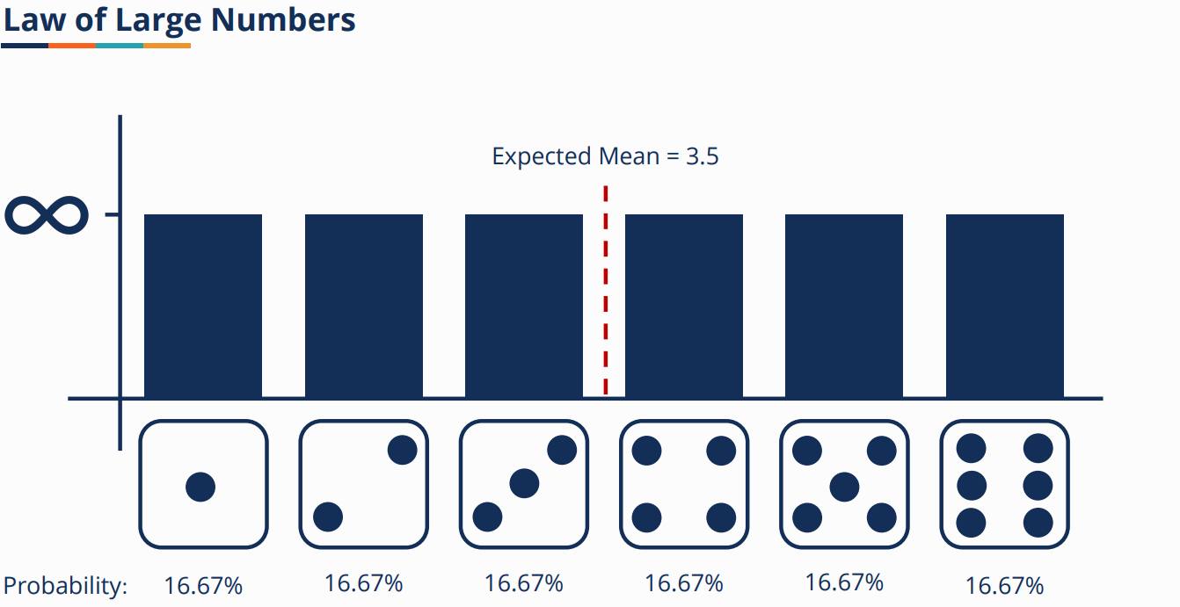

Slide 47
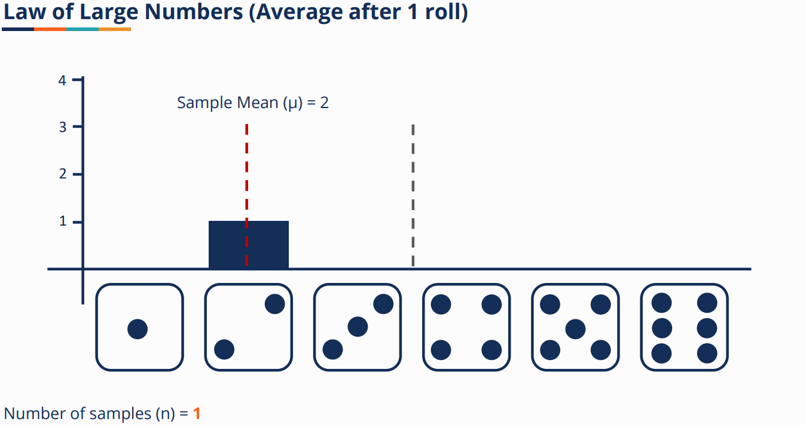

Slide 48
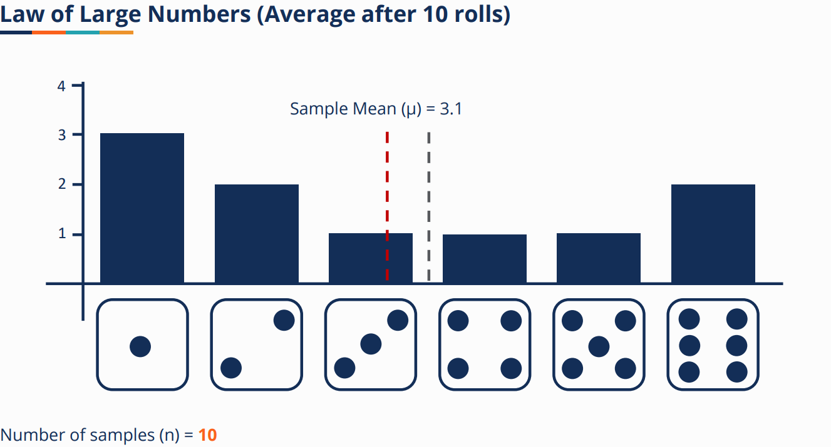

Slide 49
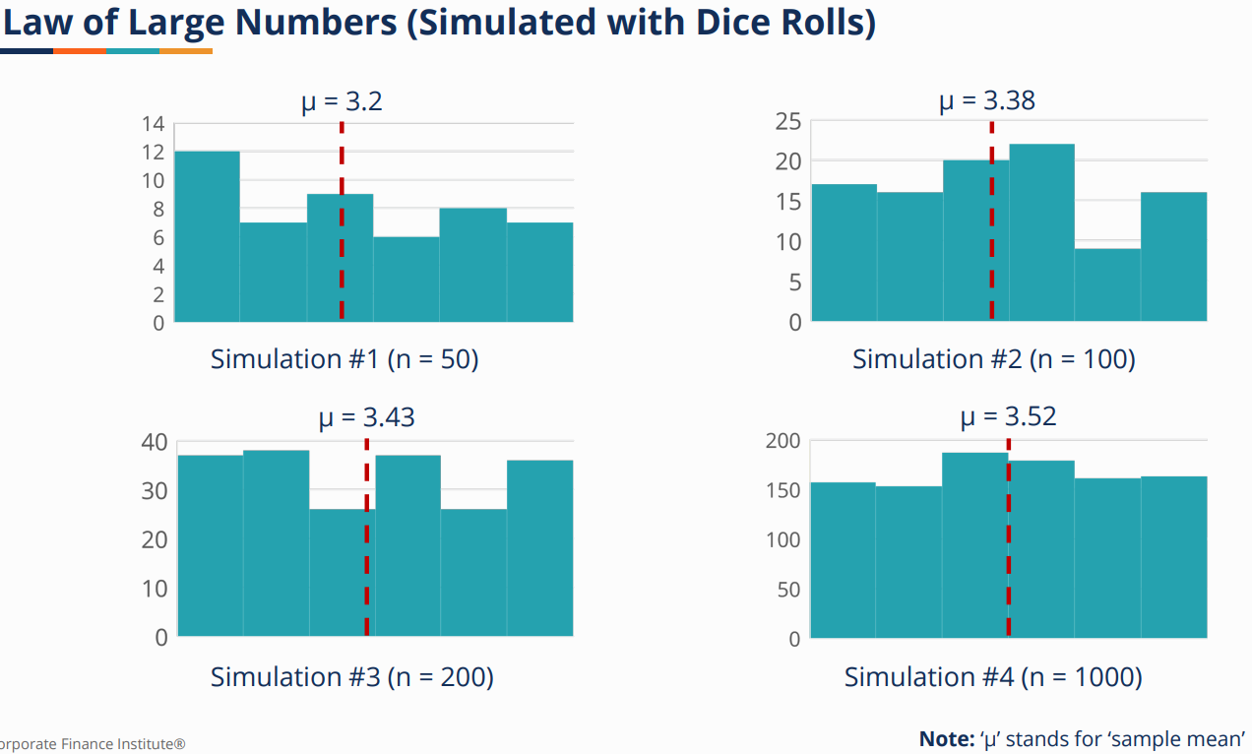

Slide 50
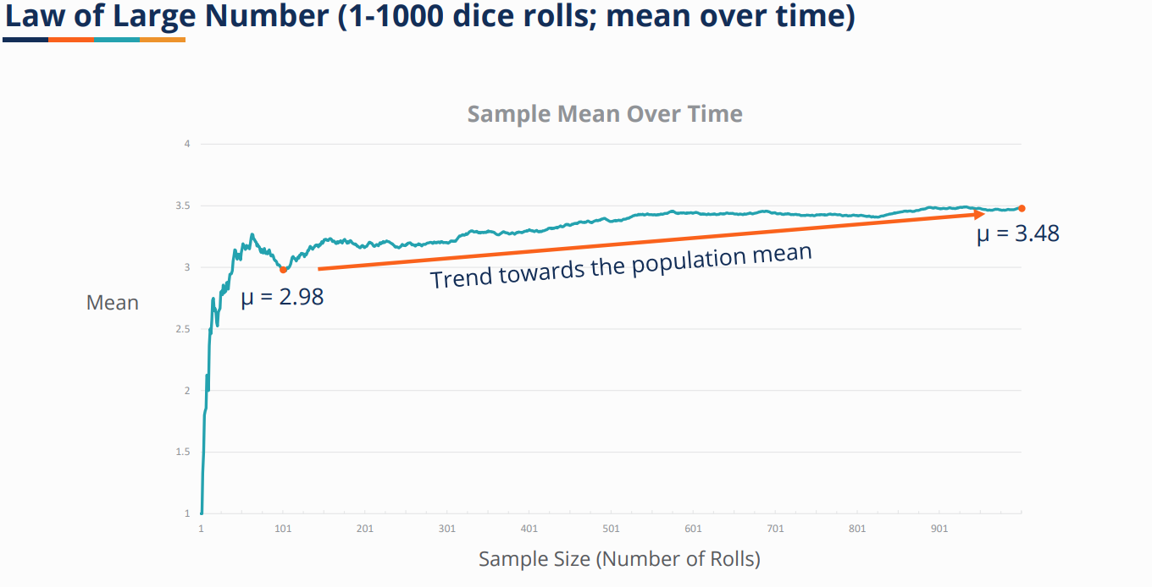

Slide 51
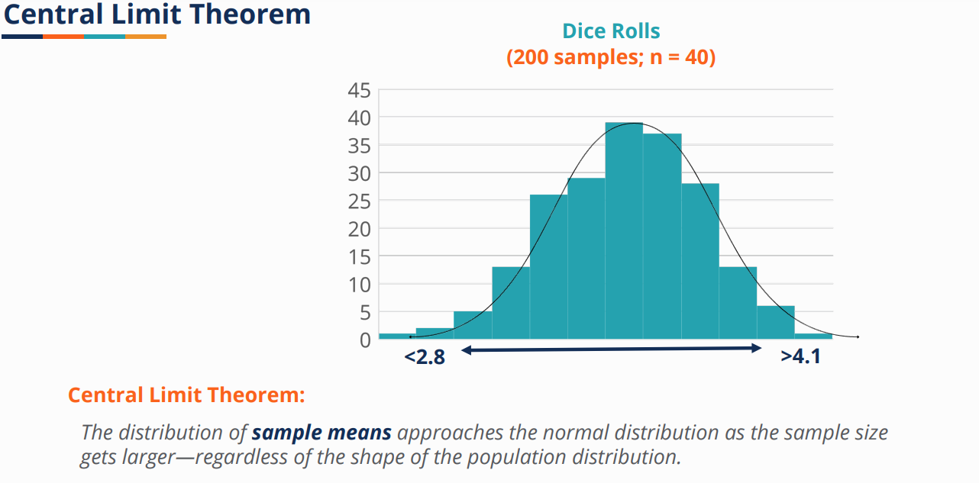

Slide 52
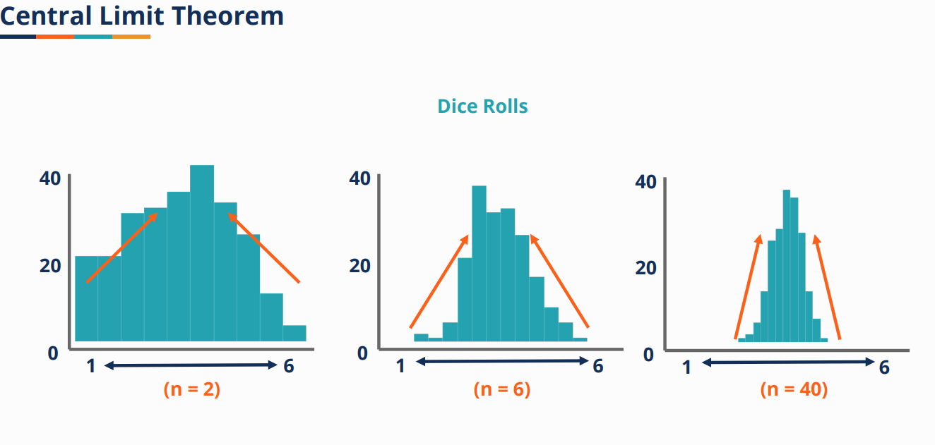

Slide 53
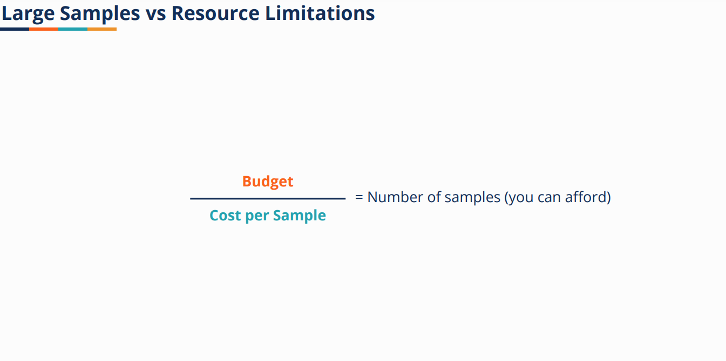

Slide 54
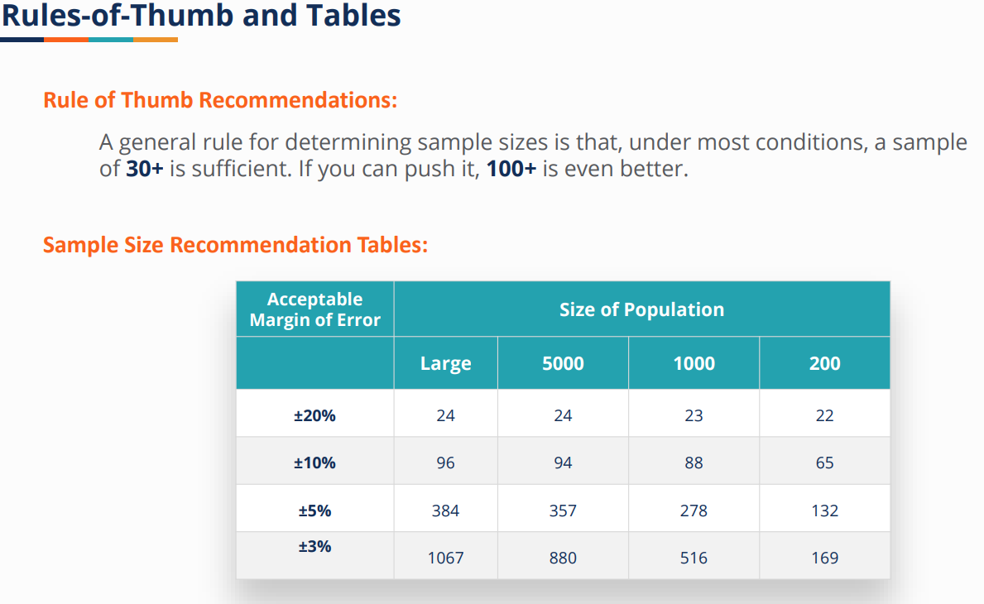

Slide 55
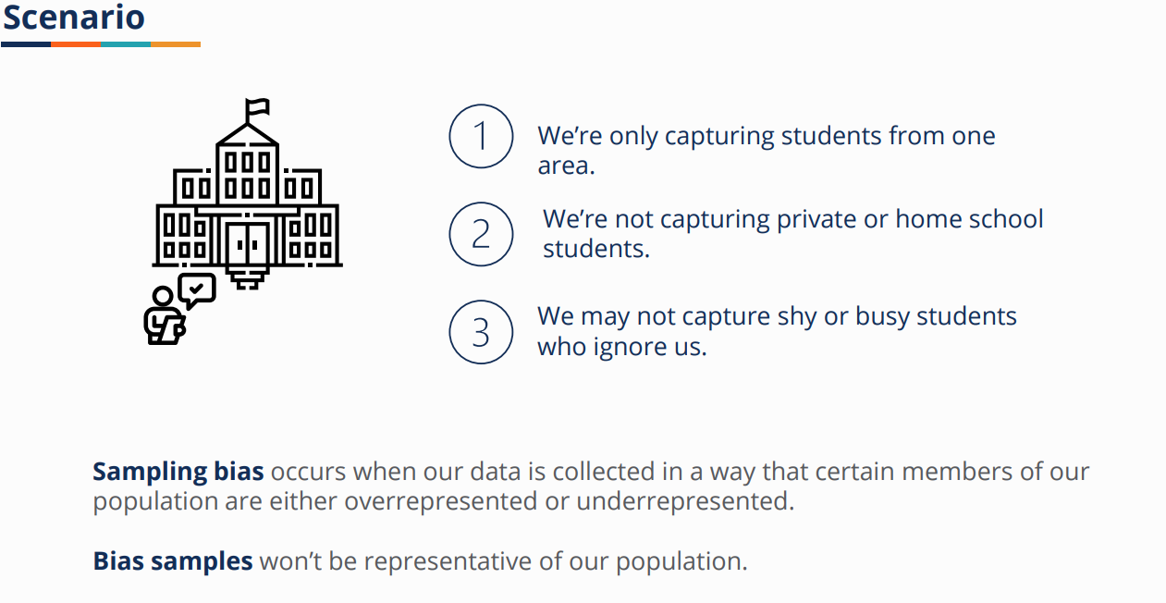
BIAS IN SAMPLE

Slide 56
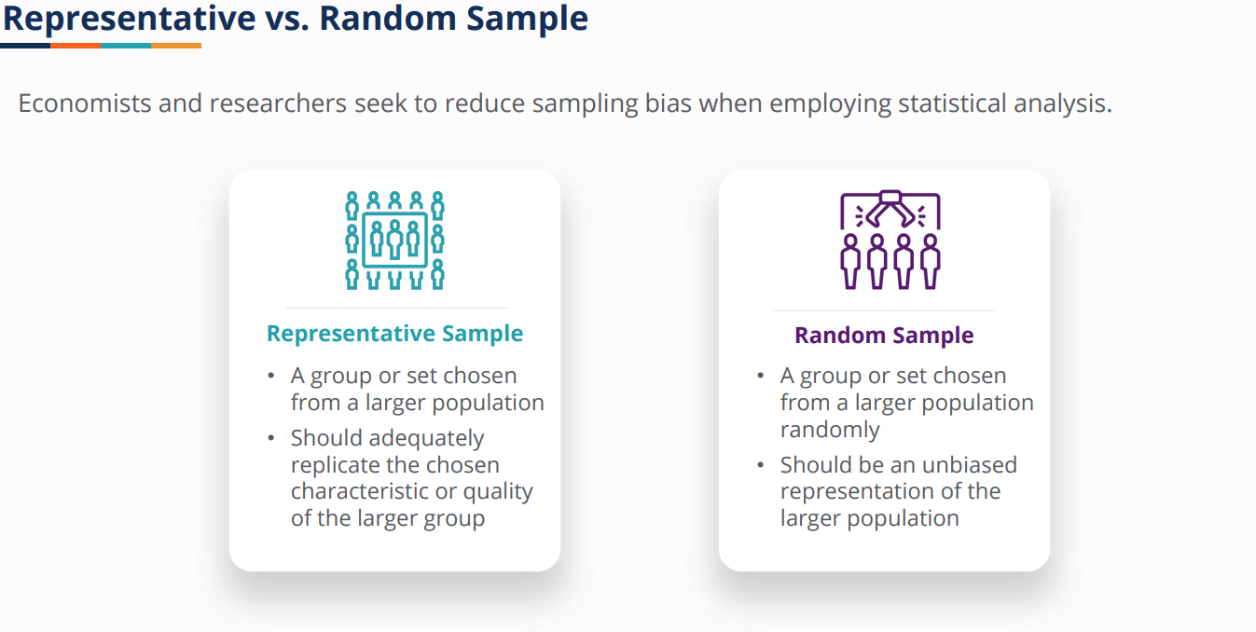

Slide 57
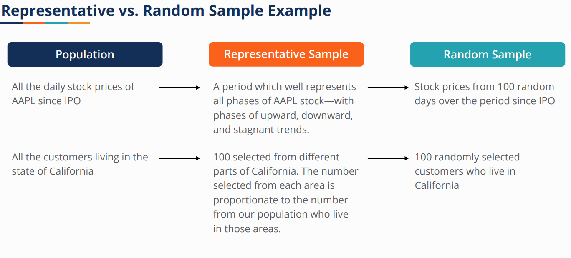

Slide 58

Hypothesis testing

Slide 59
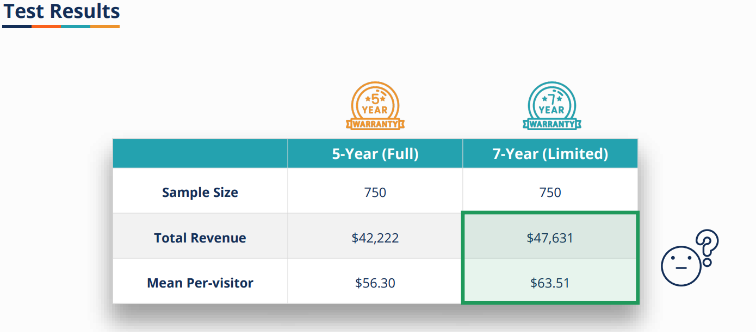

Slide 60
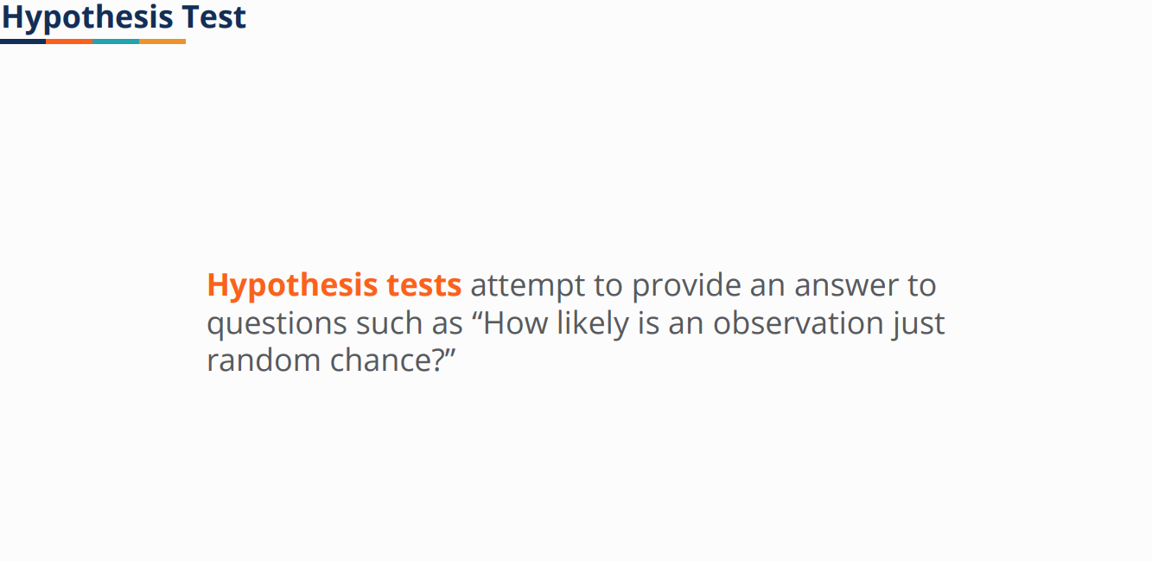

Slide 61


Slide 62


Slide 63
Hypothesis Testing
A hypothesis is an educated guess about something in the world around you. It should be testable, either by experiment or observation. For example:
A new medicine you think might work.
A way of teaching you think might be better.
A possible location of new species.
A fairer way to administer standardized tests.

Slide 64
What is a Hypothesis Statement?
If you are going to propose a hypothesis, it’s customary to write a statement. Your statement will look like this: “If I…(do this to an independent variable)….then (this will happen to the dependent variable).” For example:
If I (decrease the amount of water given to herbs) then (the herbs will increase in size).
If I (give patients counseling in addition to medication) then (their overall depression scale will decrease).
If I (give exams at noon instead of 7) then (student test scores will improve).
If I (look in this certain location) then (I am more likely to find new species).

Slide 65


Slide 66


Slide 67

Confidence level

Slide 68


Slide 69

Common confidence level

Slide 70


Slide 71

Two tail t test

Slide 72


Slide 73


Slide 74


Slide 75


Slide 76

If the p-value is more than 0.05(for confidence level 95%), then the result is not significant. If the p-value is less than 0.05, then the result is significant. If p < 0.01(for confidence level 99%), then it is highly significant, and so forth.

Slide 77


Slide 78


Slide 79


Slide 80


Slide 81

One tail t test

Slide 82


Slide 83

Estimation of error

Slide 84


Slide 85

Type1/type2 error

Slide 86


Slide 87


Slide 88


